Slide 1
Jeremiah Week 6

Slide 2
Review
626BC – Jeremiah starts preaching (during reign of King Josiah)
609BC – Jehoiakim becomes King
605BC – Jeremiah preaches in the Temple, Israel becomes a vassal state of Babylon
597BC –
First deportation of exiles to Babylon
Jehoiakim dies
Jehoiachin is king but carried into exile
Zedekiah is made king in Jerusalem
586BC-
Second deportation of exiles to Babylon
Jerusalem falls
Zedekiah is blinded, carried into exile
585BC – Jeremiah and Baruch flee to Egypt (against his better judgment)
536BC – First return of exiles to Jerusalem

Slide 3
Jeremiah 44:15-19
Sermon in Egypt
The remnant of Jews are worshipping the “queen of heaven”
Probably the Canaanite goddess Astarte. They would have imported her to Egypt.
Note their logic: everything was going great until we stopped worshipping Astarte. Obviously that was the problem, not turning away from God.
Sometimes we attribute our circumstances to the wrong things.
It’s usually to the thing that demands the least amount of change.
“I’m not getting up early enough and it’s because I keep hitting the snooze button.”
No it’s not! It’s because I’m not going to bed early enough!

Slide 4
Jeremiah 45
Comfort to Baruch
Baruch has been on the sidelines thus far, writing down Jeremiah’s sermons but not the focus of attention.
But there is no Jeremiah without Baruch.
Now Baruch’s hard work is being rewarded. God is giving him attention.
Who are the people on the sidelines of your life who deserve a note of gratitude?
These aren’t the people in the spotlight, but you couldn’t manage without them.
Write it down. In the chat or elsewhere.

Slide 5
Jeremiah 46
Judgment on Egypt
Egypt will fall in the Battle of Carchemish in 605BC
Then, Babylon will invade Egypt
Technically this didn’t happen.
Babylon took over Egyptian states (like Judah) but Egypt never fell to Babylon
Read 46:27-28
“Have no fear… for I am with you.”
In the chat: when have you felt the presence of God with you in the pandemic?

Slide 6
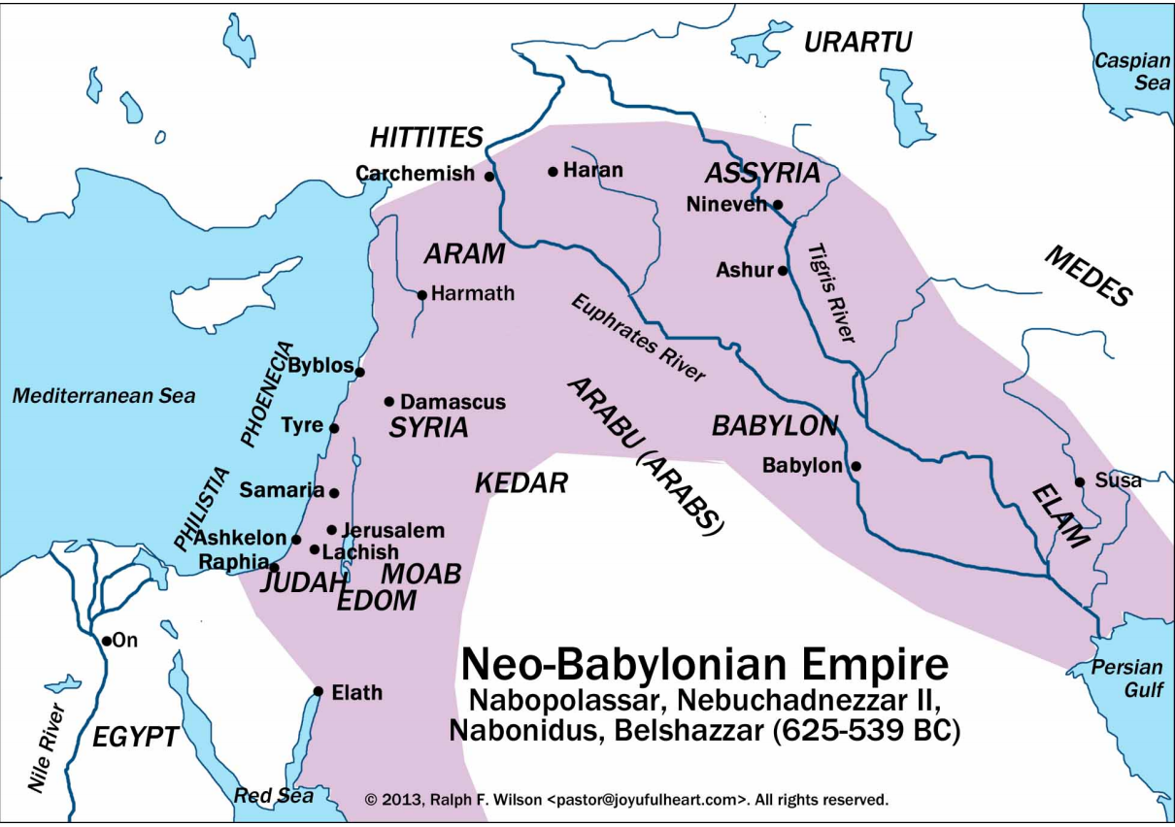
Jeremiah 47-49
Judgment on nations around Judah
Philistines
Moab
Ammon
Edom
Syria
Kedar
Hezor
Elam
Why?
Didn’t come to the aid of Judah.
Didn’t treat the refugees of Judah kindly.

Slide 7
Jeremiah 50-51
Oracle against Babylon
Jeremiah predicts the fall of Babylon. The instrument that God used to destroy Jerusalem will now be destroyed.
This happened in 539BC, well after Jeremiah’s death.
Read 50:4-10
The “land of the north” is the Persian Empire
King Cyrus the Great will defeat the Babylonians and allow the exiles to return to Judah.
Note it’s Israel and Judah that will go home, or at least their descendants a few generations later. The family will come together

Slide 8
Jeremiah 50-51
Oracle on Babylon
The problem of vengeance
Jeremiah is voicing the feelings of his people: they want revenge for what’s happened to them.
Remember Jeremiah’s core theology:
Do good, get good.
Do bad, get bad.
Repent and God may change God’s mind.
So it makes sense that this would apply to Babylon, too. They did bad, they get bad.
Do you see the cycle? What could break it?
6 For while we were still weak, at the right time Christ died for the ungodly. 7Indeed, rarely will anyone die for a righteous person—though perhaps for a good person someone might actually dare to die. 8But God proves his love for us in that while we still were sinners Christ died for us. (Romans 5:6-8).

Slide 9
Jeremiah 51:59-64
The oracle makes it to Babylon
Jeremiah sends what is now chapters 50-51 to Babylon
Seraiah must read the sermon aloud in Babylon and sink it in the Euphrates
Not as much a prediction of what will happen as a warning of what could happen.
God gives Babylon a chance to repent
How can Babylon be expected to change if they don’t hear a warning?
How can they respond to what they haven’t heard?
So God gives them a chance.
Now, because of Jesus, God takes this to the nth degree.
God is a God of second chances. And third. And fourth…

Slide 10
Jeremiah 52
Appendix
Not written by Jeremiah
Recounts the fall of Jerusalem from chapter 39
A glimmer of hope
Remember Jehoiachin? He’s the rightful heir to the throne of David. He was carried into exile after first siege of Jerusalem.
He’s still alive. He lives the rest of his days in comfort in Babylon.
The power of one. As long as one agent of God remains, there’s hope.
Matthew 1:5-16

