Slide 1
Jeremiah
Week 2
Chapters 8-16

Slide 2
Review
Jeremiah was a priest turned prophet.
Preached for about 45 years (626BC – 581BC)
During the reign of King Josiah (read 2 Kings 23:21-27)
All the way to King Zedekiah, the last King in Jerusalem
Central message: Judah has turned away from God and turned toward other gods, resulting in a doomed society.

Slide 3
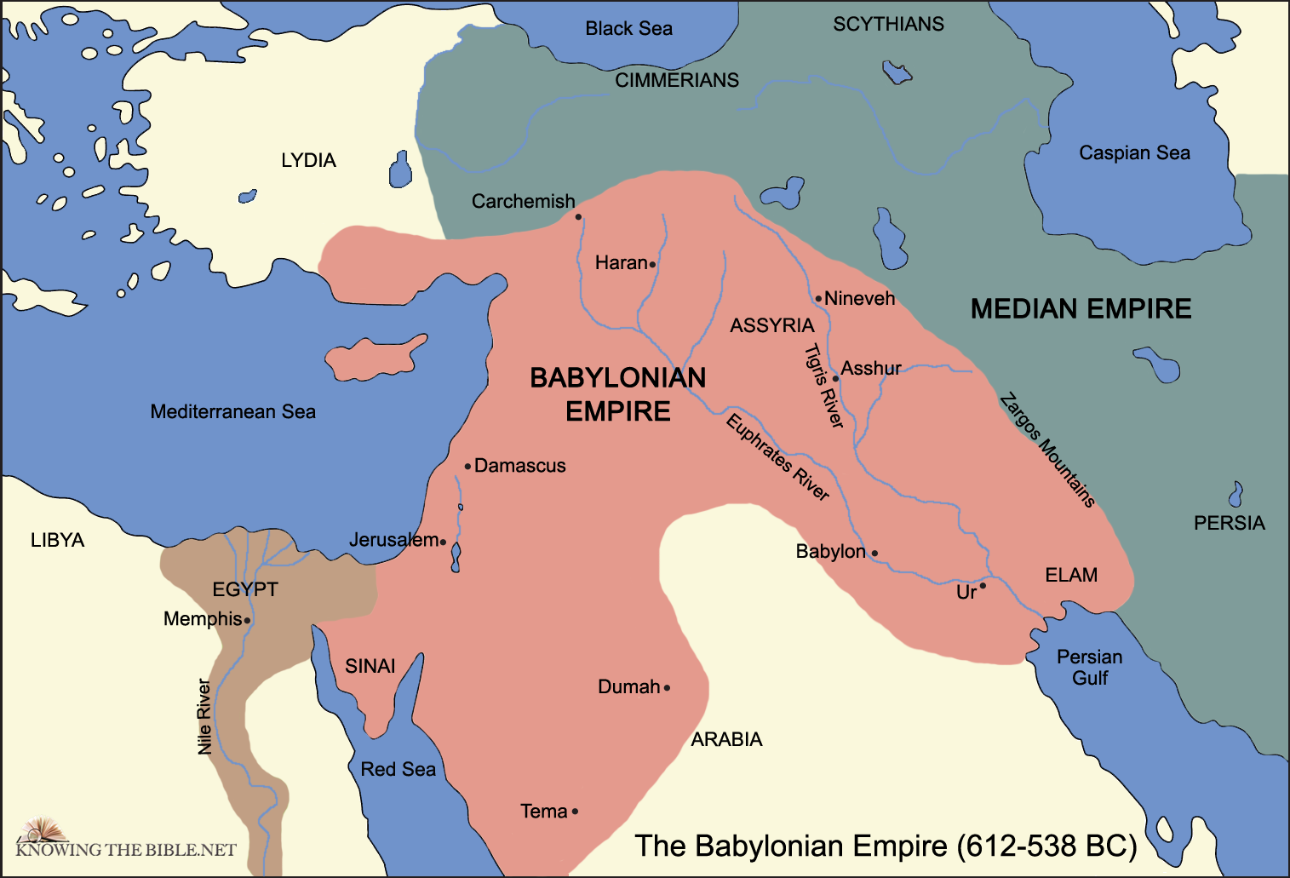
Review
For 40 years, he predicts the fall of Jerusalem to invaders from the north: Babylon.
Happens in 586BC.

Slide 4
Review
The book itself is an anthology of Jeremiah’s sermons and teachings compiled by the scribe Baruch.
And edited in Babylon by the exiles.
That’s why Jeremiah is hard to follow.
It’s not a seamless unit of writing by one author.
It jumps from sermon to sermon to teaching to sermon.

Slide 5
Jeremiah 8:18-9:3
”Is the Lord not in Zion? Is her King not in her?”
Probably a song during or after the Babylonian conquest.
Like singing the Blues during the Great Depression.
The problem is, the people live as if God was not their true King.
Balm of Gilead
An actual ointment from a tree native to Judah.
There is no cure for this people. What’s done is done. Conquest is coming.

Slide 6
Jeremiah 8:18-9:3
“a traveler’s lodging place”
Jeremiah wishes he had a quiet place to which he can retreat and grieve.
This isn’t anger. This is grief. He’s grieving in advance of the coming suffering.
Like Jesus in the Garden of Gethsemane.
And he said to them, ‘I am deeply grieved, even to death; remain here, and keep awake.’ And going a little farther, he threw himself on the ground and prayed that, if it were possible, the hour might pass from him. He said, ‘Abba, Father, for you all things are possible; remove this cup from me; yet, not what I want, but what you want.’ (Mark 14:34-36).

Slide 7
Jeremiah 8:18-9:3
Grief can be an expression of the deepest faith.
How? Faced with terrible suffering, Jeremiah and Jesus:
Give voice to their pain.
They don’t hold back.
They recognize they’re not alone.
They surrender control to God.

Slide 8
Jeremiah 9:12-16
”Who is wise enough to understand?”
He’s asking a question of theodicy: why does a good God allow evil to exist?
In this situation: the problem is the Babylonian conquest of Jerusalem and the colossal scale of human death and suffering.
The answer: sin.
Human suffering because of human violence is a product of human actions.
”forsaken my voice”: turning away from God
“followed their own hearts”: turned toward a false god

Slide 9
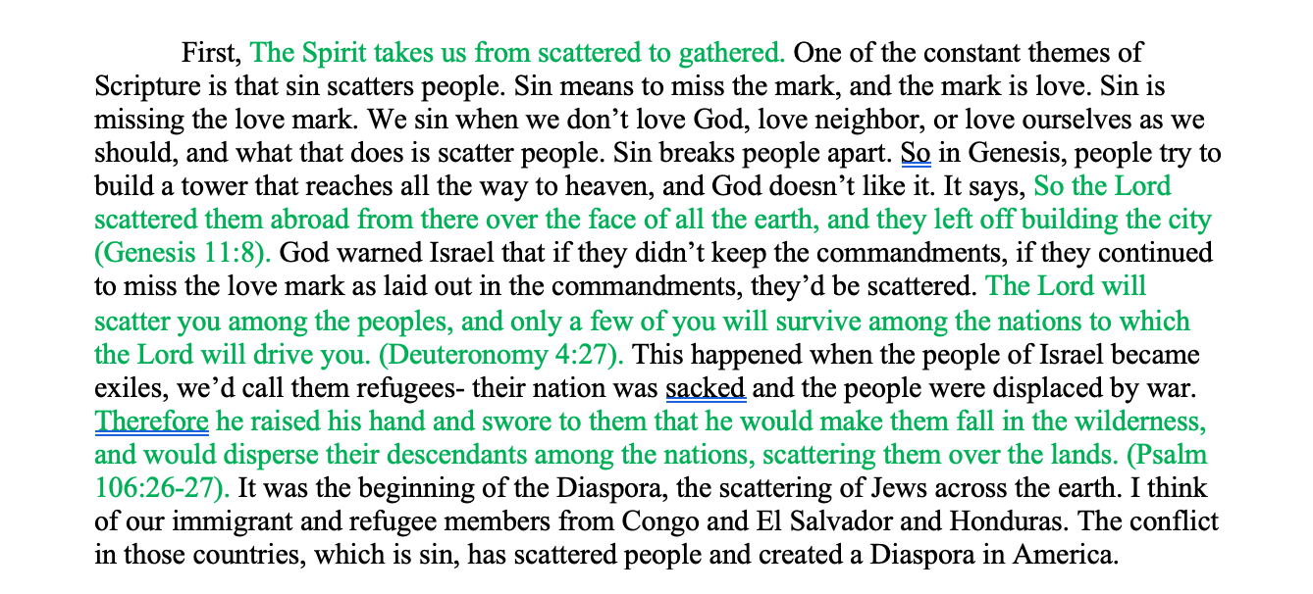
Jeremiah 9:12-16
Sin scatters people.
Sin that we do.
Sin that we do to others.
Sin pulls people apart.

Slide 10
Jeremiah 9:12-16
In the chat: where have you seen sin scatter people?

Slide 11
Jeremiah 9:23-26
The circumcised vs. the uncircumcised
All the men of Israel were to be circumcised (see Genesis 17). That was the sign of the covenant.
The nations around Israel were “circumcised” in that they had signs of a covenant between them and their gods.
Circumcision is a metaphor for all of religion– what a person is supposed to do with their life because of their faith in a god.
But here Jeremiah says: everyone is uncircumcised in the heart. Including Israel.
No one in Israel is doing religion because of a pure heart.

Slide 12
Jeremiah 9:23-26
Paul believed that the ”circumcision of the heart” had come in Jesus.
For a person is not a Jew who is one outwardly, nor is true circumcision something external and physical. Rather, a person is a Jew who is one inwardly, and real circumcision is a matter of the heart—it is spiritual and not literal. Such a person receives praise not from others but from God. (Romans 2:28-29).
The difference between inward and outward circumcision is the difference between religion for religion’s sake and religion because of a relationship’s sake.
In the chat: Why is this distinction important?

Slide 13
Jeremiah 11:18-23
The people of Anatoth (Jeremiah’s hometown) threaten him.
They want him to stop preaching bad news.
A prophet is not welcome in his hometown.

Slide 14
Jeremiah 12:14-17
A glimmer of hope for Judah and a warning to the people who harm her.
The salvation cycle.
Black = our responsibility
Blue= God responsibility
Sin
Restoration
Consequences
Repentance

Slide 15
Jeremiah 14:13-16
False prophets
Jeremiah predicted fire and fury. The false prophets predicted peace and security.
Babylon’s strength was growing. Egypt was Judah’s ally to the south but growing weaker.
The false prophets said Egypt would always come to Judah’s rescue. Jeremiah didn’t buy it.
So how can you tell if a prophet is true or false?
If the message is what people want to hear, when they need to hear what they need to hear.
The people want to hear safety and security, and the false prophets give it to them.
Salesman vs. Doctor

Slide 16
Jeremiah 15:10, 19-21
Jeremiah Stops Preaching
”Woe is me”: the people of Anatoth are getting to him
The price of preaching the truth is too high, so he stops. Probably for months to years. It’s a mid-life crisis.
But God takes him back
“If you turn back, I will take you back.”
Jeremiah experiences the salvation cycle himself
Sin (he quits his job)
Consequences (he gets depressed)
Repentance (he gets back to work)
Restoration (“I am with you, to save you and deliver you”)

Slide 17
Jeremiah 16:1-4
Jeremiah chooses to be single
God tells him not to have children.
Because the children of Judah will suffer a terrible fate.
It’s a prophetic act
An embodied sermon illustration, the first of several in Jeremiah.
His choice to be single and celibate is supposed to preach a message.

Slide 18
Jeremiah 16:14-15
A Second Exodus
Two exiles and two exoduses in the Bible
Exile 1- Promised Land to Egypt
Exodus 1- Egypt to Promised Land
Exile 2- Promised Land to Babylon
Exodus 2- Babylon to Promised Land
Go to menti.com

Slide 19
Next week
Read Jeremiah 17-25

