Slide 1
Jeremiah Not Just a Bullfrog

Slide 2
This is what you can expect
Six weeks at 7:30pm on Mondays
June 28
July 5
July 12
NO CLASS ON JULY 19
July 26
August 2
August 9
On Zoom

Slide 3
This is what you can expect
A survey on the Book of Jeremiah
We’ll cover 8-9 chapters each week
Read these in advance
We’ll discuss the major points (rather than going verse by verse)

Slide 4
This is what you can expect
Tonight:
A bit of historical context
Jeremiah 1-8

Slide 5
Who was Jeremiah?

Slide 6
Who was Jeremiah?
Read Jeremiah 1:1-3
A priest who switched careers and became a prophet
From Anatoth
A preaching ministry of about 45 years (626BC -581BC)

Slide 7
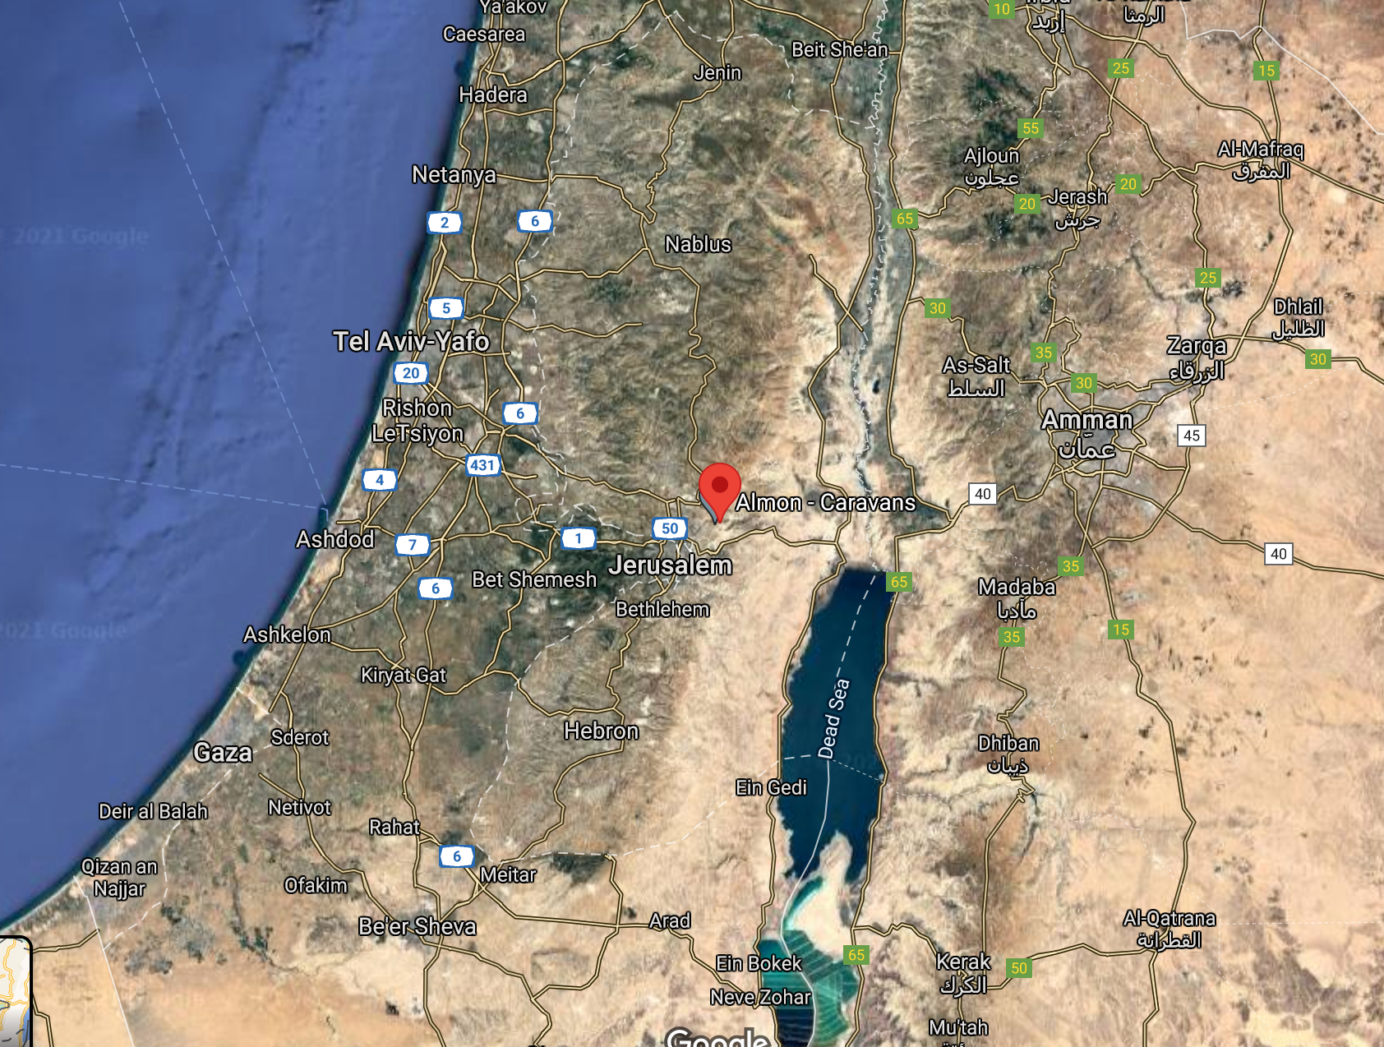
Who was Jeremiah?

Slide 8
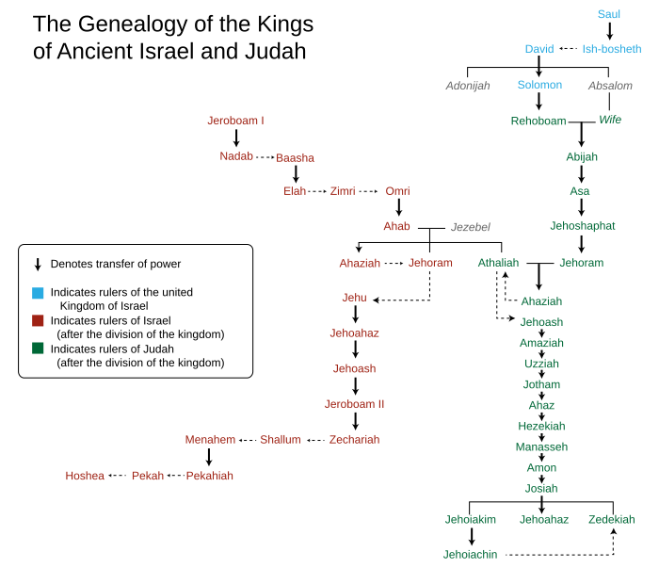
Who was Jeremiah?
Preaches from the middle of King Josiah to the end of the King Zedekiah
Then a few years afterward, when Jeremiah is exiled to Egypt

Slide 9
Who wrote Jeremiah?
Read Jeremiah 36:1-6
Jeremiah dictated his sermons to a scribe named Baruch.
Why dictate? It’s most likely that Jeremiah couldn’t read or write.
Baruch was the editor of Jeremiah’s sermons and stories, making Jeremiah a book of biography as much as prophecy.
The exiles carried the scroll into exile, where the scroll was copied and redacted further.
Jeremiah is the closest Old Testament analogy to a Gospel.

Slide 10
Jeremiah 1:4-10
Jeremiah receives the call to preach as a pre-teen or teenager.
He thinks he’s unqualified to do the job.
For Moses, the problem was his stutter.
For Jonah, the problem was his bitterness.
For Jesus, the problem was his “illegitimate” birth.
For Paul, the problem was his past.
For Jeremiah, the problem was his age.
You know you’re called when you’re the one doing the job and it doesn’t make sense that you’re the one doing it.
Jeremiah’s words will “destroy” and “build up.”

Slide 11
Jeremiah: 1:4-10
A new take on calling. Calling isn’t the “one thing you’re supposed to do with your life.”
Calling is the essential work that no one else but you can do, even if other people are better qualified.
In the chat: when did you have a “word” to speak and you didn’t want to speak it, but you found yourself speaking it anyway?

Slide 12
Jeremiah 1:11-19
A play on words
Almond tree in Hebrew is shaqed
Watchtower in Hebrew is shoqed
Jeremiah is to be the sentry on the watchtower who sounds the alarm that trouble is coming.
A boiling pot, pouring out away from the north
Trouble will come from the north: the Babylonian army
Why? “for all their wickedness in forsaking me; they have made offerings to other gods, and worshipped the works of their own hands.”

Slide 13
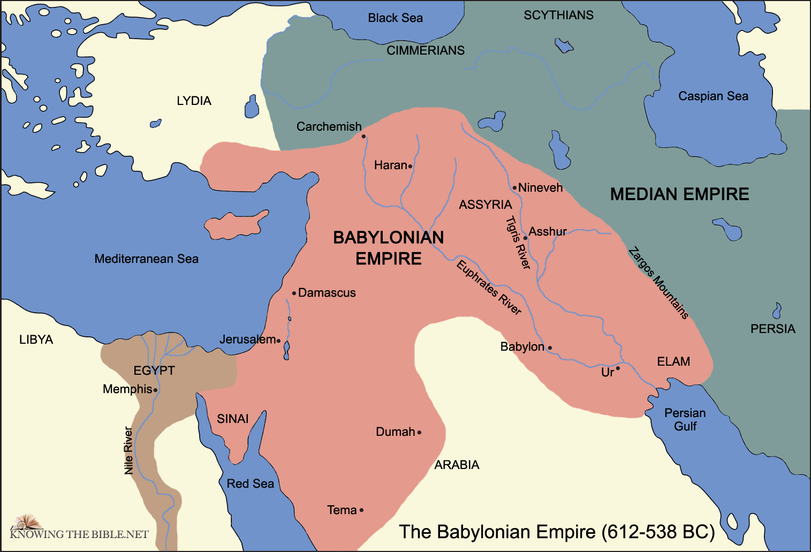
Jeremiah 1:11-19
Trouble will come in 586BC when the Babylonian Empire destroys Jerusalem.
Jeremiah sees this 40 years before it happens.

Slide 14
Jeremiah 2:13, 26-28
The twin dangers to Israel
Turning away from God (the fountain of living water)
Turning toward false gods (cracked cisterns that hold no water)
menti.com

Slide 15
Jeremiah 3:1-3
Idolatry is adultery
Israel has “lain with” gods of other cultures
Likely under the reign of King Manasseh, see 2 Kings 21
Baal, Asherah, possibly Molech
Note references to “the land”
Idolatry has consequences for real-world life

Slide 16
Jeremiah 5:26-31
“Catch human beings,” likely in debt, forcing the poor to sell off property and family members
The causes of justice, the orphan, and the needy have been forsaken
Preachers lie and priests cover-up the lies.

Slide 17
Jeremiah 7:1-11
Jeremiah preaches in the Temple. Calls the Temple a “den of robbers.”
Sound familiar?
The prophet who looks most like Jesus is Jeremiah.
See v.5-7. Jeremiah’s chief complaints are:
Oppression of the “alien, the orphan, and the widow”
Violence
Worship of false gods
God won’t dwell in Temple until the people’s actions dwell in God.

Slide 18
Jeremiah 7:1-11
Jeremiah is reinterpreting what Israel’s religion should be.
Until now, it was about sacrifices in the Temple.
Now, it’s about integrity and right living.
Integrity to who God is.
Right living because of who you believe God is.
Again, sounds a lot like Jesus.
In the chat: how are we reinterpreting Christianity in our time, as we come out of the pandemic?

Slide 19
Q&A and next week
Any questions?
Next week: Jeremiah 8-16

