Slide 1
Gospel of Mark Week 3

Slide 2
Chapters 4 and 5 Use chat for questions menti.com

Slide 3
Review
Prologue: Mark 1:1-15
John the Baptist, baptism of Jesus, Jesus sent into the wilderness
John arrested, Jesus goes to Capernaum in Galilee, starts proclaiming the Kingdom of God
Act 1: Mark 1:16-8:26
Scene 1: Mark 1:16-2:12
Five healing stories, back to back
The point: Jesus has the legitimacy to heal people.
Scene 2: Mark 2:12-3:6
Five controversy stories, back to back
The point: Jesus has the legitimacy to speak for God.
Scene 3: Mark 3:7-6:6
The movement in Galilee grows
The point: Jesus is the leader of the Kingdom movement.

Slide 4
Review
20and the crowd came together again, so that they could not even eat. 21When his family heard it, they went out to restrain him, for people were saying, ‘He has gone out of his mind.’ 22And the scribes who came down from Jerusalem said, ‘He has Beelzebul, and by the ruler of the demons he casts out demons.’ (Mark 3:20-22, in Nazareth)
14 Now he was casting out a demon that was mute; when the demon had gone out, the one who had been mute spoke, and the crowds were amazed. 15But some of them said, ‘He casts out demons by Beelzebul, the ruler of the demons.’ (Luke 11:1-15, somewhere en route to Jerusalem)

Slide 5
Review
“Mary, Did You Know?”
In Luke, yes. Luke has a high opinion (the correct opinion) of women. It’s the women, the poor, and the outsiders who get Jesus.
In Mark, no. In Mark, only Jesus and the demons understand who Jesus is.
Mark either doesn’t know about Gabriel’s visit or doesn’t feel it’s important enough to include.
Conclusion: Mary knew the correct title but not the correct character of Jesus. She knew his title of Son of God, but didn’t know what kind of Son of God he’d be.
We shouldn’t blame Mary. Nobody saw this coming. ”Son of God” = Conquering Hero, not Sacrificial Servant.

Slide 6
Read 4:1-9 (13-20)
Left Nazareth for Galilee. Remember his rejection in Nazareth. He never returns.
Chapter 4 is the largest block of teaching in Mark.
Mostly parables
“Para-bole”: thrown alongside
Short stories with multiple meanings thrown alongside the story itself

Slide 7
Read 4:1-9 (13-20)
Parable of the Sower
Sower= one who preaches the Word (wisdom) of God. It’s Jesus, then the apostles.
Birds = Satan. Satan snatches up the Word before it can take root. That doesn’t mean all hope is lost. It means the preacher needs to keep trying.
Rocky ground = people who are eager to follow Jesus, but when it’s hard to live by Kingdom values, they stop trying.
Root = church community. You need community for the Word to take root, and to persist in the Christian life.
Thorns = cares of the world and the lure of wealth.
Good soil = people who do three things well: hear the Word, accept it, and do it.

Slide 8
Read 4:1-9 (13-20)
Parable of the Sower
Copied almost word for word in Matthew and Luke (remember Matthew and Luke used Mark as a source)
Answers questions like, When is the church most effective at reaching people? Why are some people more open to the gospel than others?
Gives practical wisdom to the church:
Preachers much keep preaching despite high failure rate.
Community is essential to sticking with the Christian life.
Warning: don’t want what the world wants (like wealth and approval, those are thorns)
Must do the Word in order to grow
What else? In the chat, what other practical wisdom does this parable give to the church?

Slide 9
Read 4:10-12
The secret (literally, mystery) is the Kingdom.
It’s a message some have heard and others haven’t (yet).
Almost like a conspiracy theory. Some will buy into it, others won’t.
Jesus cites Isaiah 6:9-10
Another answer to the question, "Why are some people more open to the Gospel than others?”
Those on the “outside” aren’t on the “inside” yet. How do you get on the “inside”? Commit to the Gospel.
Some things you can’t know until you do them.
You have to do the Kingdom (as expressed in the the parables) to understand the Kingdom.

Slide 10
Understanding the Kingdom
happens after
committing to the Kingdom.

Slide 11
Read 4:21-25
Jesus didn’t come to keep a secret but tell a secret.
The secret of the Kingdom is being disclosed to the world. Now it’s an open secret.
“The measure you give will be the measure you get."
Like in AA- It works if you work it.
The Kingdom is a process in your life. It works if you work it.

Slide 12
Read 4:26-34
The Kingdom is a process you have to commit to, and it’s an organism that grows on its own.
We work it and God works it.
Remember, the Kingdom is God’s ways being the only ways, and our ways are no ways.
It happens with us and without us.

Slide 13
Read 4:35-41
“Just as he was”: Jesus is exhausted.
Crossing the lake is the only way to escape the crowd and get some rest.
“Teacher, do you not care?”
We all feel that way sometimes.
Does God even exist? If so, does God even care?
Jesus exorcises the storm
“Rebuked,” like rebuking a demon
“Peace. Be still.”: literally, “Silent! Be muzzled.”
Jesus is Lord of the Storms, inner and outer.
(David, don’t forget the Zoom poll.)

Slide 14
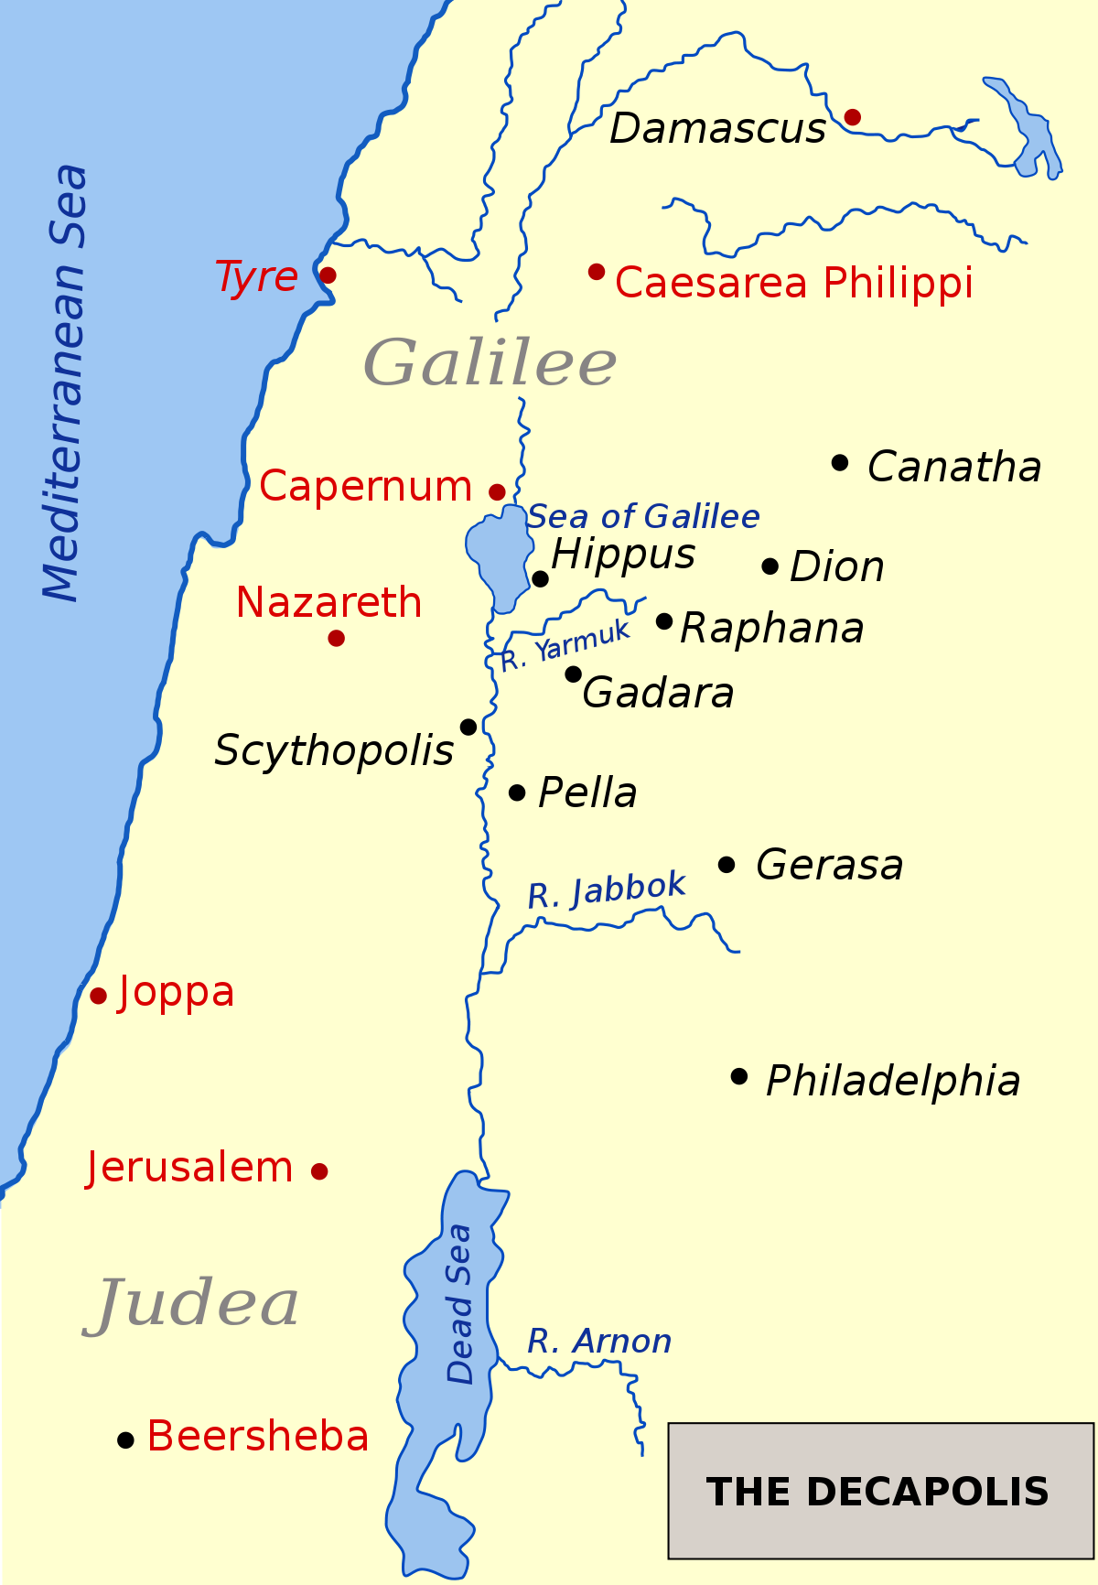
Read 5:1-13
Everything about the place is unclean:
The demons
The man
The people
The land
The tombs
The pigs
Are they unclean spirits or mental illnesses? Same thing.
Still, the only people who “get” Jesus aren’t people. They’re demons.

Slide 15
Read 5:1-13
Legion
A unit of the Roman military of four to five thousand men.
Multiple meanings:
The land is “possessed” by the Roman occupying force.
The man is “possessed” by mental illnesses.
The village is “possessed” by inhumane values.
Pigs
Jesus bargains with Legion
The lake represents Disorder (like Genesis 1:2), so Jesus sends the spirits back to where they came from

Slide 16
Read 5:14-20
Jesus single-handedly cripples the town’s economy. Of course they want him gone.
But who do the villagers love more- the man or the pigs?
They, too, are possessed by the wrong values.
Demons work on all levels- individual, families, organizations, churches, communities, nations.
Demons are the unseen evil forces that drive real world outcomes.
The man becomes the first Gentile evangelist. Maybe he plants the first Gentile church.
He’s restored to his friendships.
Jesus offers a holistic vision of salvation.
Salvation at all levels-- individual, families, organizations, churches, communities, nations.

Slide 17
Go to menti.com

Slide 18
Read 5:21-34
Back in Jewish territory
Jairus is the first religious leader to see Jesus as good.
Born of necessity. His daughter is sick.
Sometimes we only come to Jesus because we have no one else to turn to.
But Jesus is interrupted.

Slide 19
Read 5:21-34
The Hemorrhaging Woman
Like Jairus, she has “heard about Jesus.” He’s her only hope.
She sneaks through the crowds because technically she’s unclean.
These aren’t doctors in the modern sense. These are “miracle workers” who sell magic tricks.
She isn’t “made well” (literally, saved) until her personal encounter with Jesus.
Begs the question, what does salvation mean? It’s all levels- physical, spiritual, social, mental.
"Go in peace”- shalom, the Hebrew world for wellness. Salvation is wellness.

Slide 20
Read 5:35-43
Jairus’ Daughter
Why only Peter, James, and John? Jesus must have an inner circle.
Jairus believes. The crowd laughs.
Like the hemorrhaging woman, faith manifests as desperate longing.
Faith isn’t mere belief. It’s born of necessity, desperation, and yearning aimed at one person.
The crowds around Jesus receive healing, but they don’t have faith.
”Don’t tell anyone”
Jesus heals anyone and everyone who comes to him.
And he doesn’t want to be a divine vending machine.

Slide 21
Next week: Chapters 6 and 7

