Slide 1
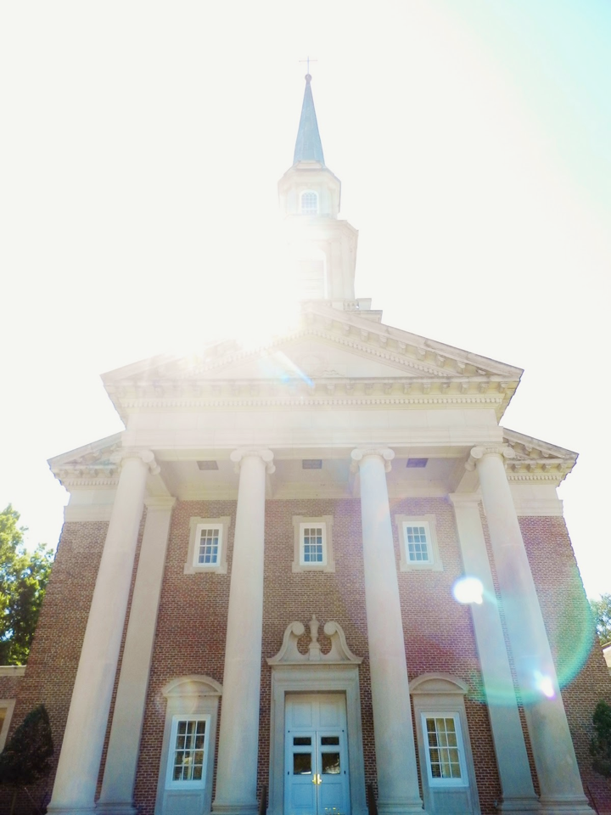
Safe Sanctuary Training
Reducing the Risk of Abuse in the Church
St. Luke’s UMC Student Ministry
Houston TX
St. Luke’s United Methodist Church
Student Ministry

Slide 2
Introduction to St. Luke’s Policy
Throughout the gospels, Jesus provides teachings on providing a peaceable kingdom for all of God’s people, including our most precious gifts, our children and youth (Matthew 5:9, Luke 18:15-17). The peaceable kingdom begins with sanctuary, which is to be a community of protective nurture and harmony (Psalms 20:1-2, 27:4-5).

Slide 3
Risk Reduction Goal
The disturbing and traumatic rise of physical, verbal and sexual abuse has claimed the attention of our nation and society. St. Luke’s United Methodist Church is committed to providing protective care of all children, youth, vulnerable adults and volunteers who participate in church sponsored activities.

Slide 4
WHY Safe Sanctuary?
As Christians, we are called to create a safe sanctuary in our church.
Prevent the occurrence or even the appearance of abuse.
Protect workers from false accusations and/or suspicions.

Slide 5
Scope of Policy
This policy shall apply to all persons including all paid and unpaid leaders who have direct or indirect contact with children and youth who participate in St. Luke’s United Methodist Church events and activities.

Slide 6
Safe Sanctuary applies to:
Any event on or off campus which occurs in the name of St. Luke’s United Methodist Church.
Off-campus events include, but are not limited to: sporting events, mission trips, Sunday School socials, Bible studies, field trips, etc.

Slide 7
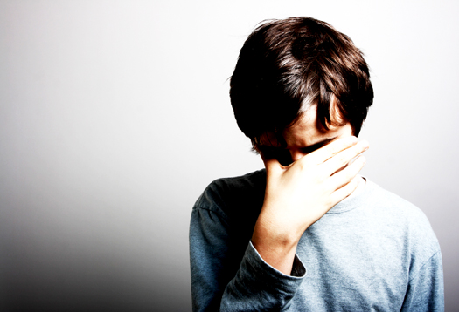
Types of Abuse
Physical
Verbal
Sexual

Slide 8
What is Physical Abuse?
Any act of omission or act that endangers a person’s physical or mental health, including but not limited to any intentional physical injury caused by the individual’s caretaker. Physical abuse may result from punishment that is overly punitive or inappropriate to the individual’s age or condition.

Slide 9
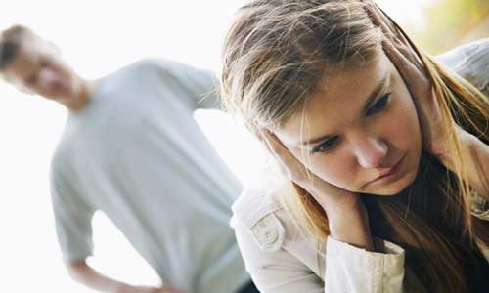
What is Verbal Abuse?
Any verbal act that humiliates, degrades, or threatens any child, youth or vulnerable adult.

Slide 10
What is Sexual Abuse?
Sexual abuse of minors includes touching them in inappropriate ways such as fondling, inappropriate touching of the minor's body, and inappropriate kissing.
Non-touch abuse includes making remarks of a sexual nature, showing the child explicit pornographic materials, or making the minor watch others engaged in sexual activity.

Slide 11
Remember:
With abuse it’s not just what you do… it also includes what you do NOT do.
Not stepping in to stop an abusive action or situation is also abuse!
You must be proactive to prevent abuse or situations that might lead to abuse.
If you can stop abuse, then stop it, and if you know abuse is happening, report it immediately!

Slide 12
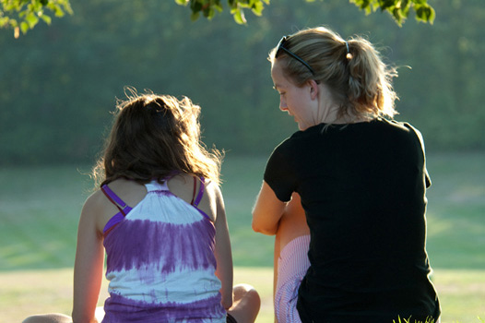
Who must complete Safe Sanctuary training?
St. Luke’s Staff
Any volunteer who comes into direct or indirect contact with children or youth

Slide 13
What is the certification process?
Read and complete the complete policy and application.
Complete this training presentation, including the quiz at the end.
The individual is certified upon satisfactory completion of the above steps.

Slide 14
Plan for Reducing the Risk of Abuse

Slide 15
Plan for Response to Known Incident of Abuse:
I. Assess needs for emergency care for the victim
A. Notify parents and/or other legally responsible adult
B. Provide emergency healthcare as needed, including 9-1-1
1. First Aid
2. Emergency services
3. Hospital emergency room
C. Arrange for crisis counseling and/or long-range counseling where deemed appropriate.
I. Assess needs for emergency care for the victim
A. Notify parents and/or other legally responsible adult
B. Provide emergency healthcare as needed, including 9-1-1
1. First Aid
2. Emergency services
3. Hospital emergency room
C. Arrange for crisis counseling and/or long-range counseling where deemed appropriate.

Slide 16
Plan for Response (continued):
II. Take precautions to secure the area
A. Maintain the integrity of the area and
protect all evidence for the professional
investigation.
III. Assisting the victim and victim's family
A. Obtain medical help as needed. The care
and safety of victim is the first priority.
B. Take all allegations seriously and do not prejudge the situation
C. Offer and provide pastoral resources as needed
1. Show care and support to prevent further hurt

Slide 17
What if the media is involved?
Senior Pastor or designated representative will be informed of all details of the incident and will release any information that is to be disseminated to the media
IV. St. Luke’s will:
A. Notify legal authorities as required
1. Report incident to Children's Protective Services
2. Immediately contact church's insurance carrie
3. Inform the St. Luke’s Board of Trustees, any other appropriate church body,
and church legal counsel
Please note:
Church staff will be informed of incident on a "need to know" basis (to ensure privacy of the victim and/or accused) and their support enlisted as needed
Full cooperation must be given to civil authorities under the guidance of church
attorney.

Slide 18
What should I do?
Document Actions Taken
A. Document all your efforts at handling the incident
B. Do not attempt an in-depth investigation.
1. This should be left to professionals who are familiar with this type of case. This is to protect the rights of the victim and the accused.
2. Individual files will keep with all documented actions, conversations, etc.
C. File will be retained in a locked and secure area to insure privacy and confidentiality.

Slide 19
Dealing with the Accused
A. Remove the accused/abuser from any further contact with children, youth, vulnerable adults and staff
B. Treat the accused with dignity and support
1. Do not confront the accused until the safety of
the child, youth or vulnerable adult member is
secured
2. Offer and provide pastoral care to family of
abuser as appropriate
3. Offer outside counseling services as appropriate
4. Refer to outside clergy if deemed more desirable
or as requested by the family

Slide 20
Hallmarks of our
Safe Sanctuary Policy

Slide 21
Line of Sight
Stay visible to others.
Keep the door open.
Stay in an area where others can see you.
Try to always have two certified persons present whenever a child or youth is present.

Slide 22
Health Emergencies
First aid kits and AED machines are located in numerous areas. Familiarize yourself with locations. (Kits are located in the Student Ministries kitchen area.)
Do not hesitate to call 911 if needed.
Contact a staff person as soon as possible.

Slide 23
Setting Boundaries
Physical boundaries change as an individual ages. Holding a young child in your lap is appropriate. Holding an older child or youth in your lap is not appropriate.
Always be aware of where a conversation might go. Steer conversations appropriately.
If you feel boundaries are being violated, allow great distance to come between you and the young person.
Contact a staff person if you feel uncomfortable with a situation.

Slide 24
Who is a
“responsible party”?
Children, older youth and college students may be used in supervisory situations with children. (Example: Teen Staff at Vacation Bible School)
Anyone under the age of 21 is considered an assistant leader and not “in charge” of youth.

Slide 25
Overnight Accommodations
It is strongly recommended that two adults (or for children, one adult and one older youth) be present in each room or in close proximity to the room.
If only one adult is present, there must be more than one child/youth present.
Adults are not to sleep in the same bed with a child/youth.

Slide 26
PLEASE REMEMBER:
It is not the intent that matters…
IT IS HOW IT IS RECEIVED THAT IS THE ISSUE!

Slide 27
Who to contact about our Safe Sanctuary policy:
Rob Dulaney
Director of Student Ministries – rdulaney@stlukesmethodist.org
Brindley Ginn
Associate Director: High School – bginn@stlukesmethodist.org
Joseph Patty
Associate Director: High School – jpatty@stlukesmethodist.org
Savannah Burch
Associate Director: Middle School – sburch@stlukesmethodist.org
Tim Helwege
Associate Director: Middle School – thelwege@stlukesmethodist.org
Tracy Velarde
Administrative Coordinator – tvelarde@stlukesmethodist.org

Slide 28
What’s next?
While it’s fresh on your mind, take the quiz on this presentation.
The quiz is located here:
https://www.stlukesmethodist.org/safe-sanctuary-students/
Here is the link to St. Luke’s Safe Sanctuary Policy:
http://www.stlukesmethodist.org/pages/student_parent
Thank you for your dedication to the students of St. Luke’s UMC!

